Slide 1
E-COMMERCE OLIST STORE ANALYSIS

Slide 2
TOPICS
1. INTRODUCTION
2. OVERVIEW
3. KPI’S
4. INSIGHTS & RECOMMENDATIONS
5. CONCLUSION

Slide 3
OVERVIEW
THE OLIST STORE ANALYSIS PROJECT AIMS TO ANALYZE CUSTOMER PURCHASING PATTERNS AND PAYMENT STATISTICS ON AN E- COMMERCE PLATFORM, OLIST. THIS PROJECT COVERS SEVERAL KEY PERFORMANCE INDICATORS (KPIS) SUCH AS WEEKDAY VS WEEKEND SALES, PAYMENT STATISTICS, DELIVERY TIME, AND CUSTOMER BEHAVIOR. THE ANALYSIS IS BASED ON NINE CSV FILES, WHICH ARE CLEANED AND MANIPULATED TO EXTRACT VALUABLE INSIGHTS.

Slide 4
KPI’S
WEEKDAYS AND WEEKEND PAYMENT STATISTICS
PAYMENT TYPE WITH REVIEW SCORE 5
AVERAGE NUMBERS OF DELIVERY DAYS TAKEN FOR PET SHOP
AVERAGE PRICE AND PAYMENT VALUE OF SAO PAULO CITY
AVERAGE SHIPPING DAYS VS REVIEW SCORES

Slide 5
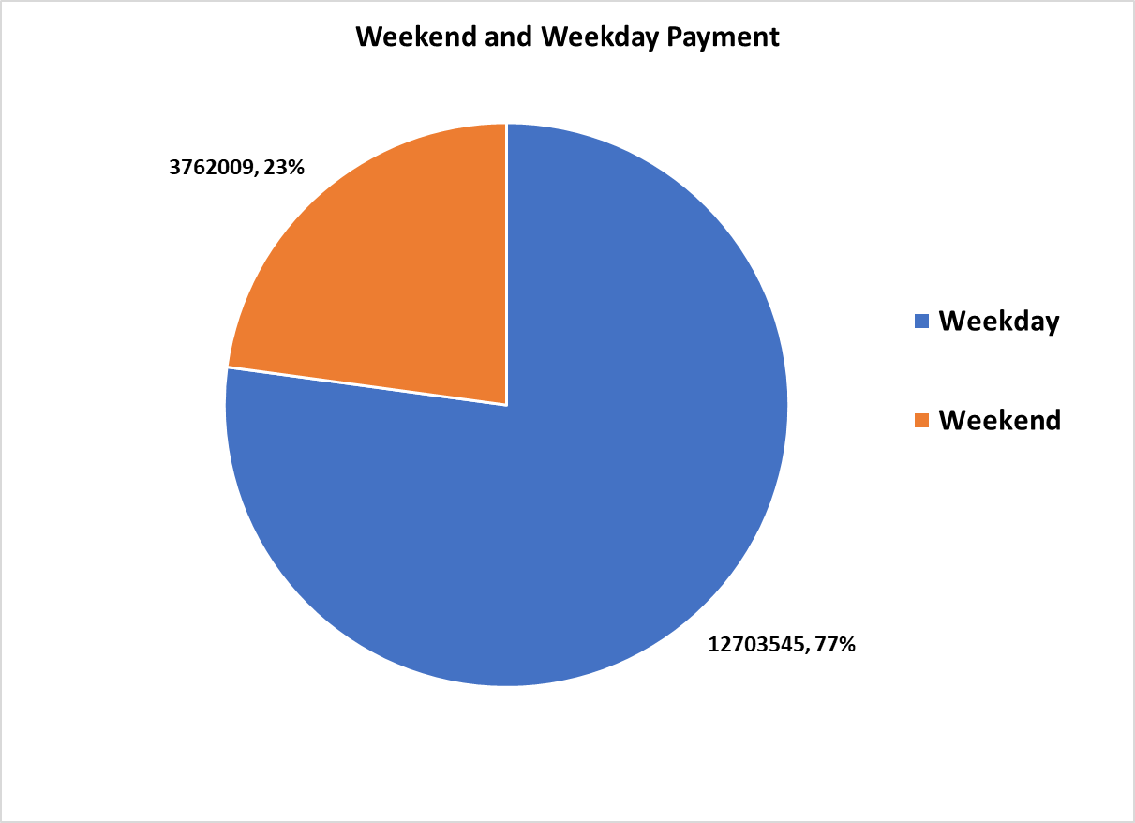
WEEKDAY VS WEEKEND PAYMENT STATISTICS
KPI - 1
THIS ANALYSIS COMPARES CUSTOMER PAYMENT
ACTIVITY ON WEEKDAYS AND WEEKENDS, OFFERING
INSIGHTS INTO BUYER BEHAVIOR AND PAYMENT
PREFERENCES.
WEEKDAY PAYMENTS: 12,703,545 TRANSACTIONS (77%)
WEEKEND PAYMENTS: 3,762,009 TRANSACTIONS (23%)
THIS KPI ANSWERS QUESTIONS LIKE, WHICH DAY OF THE
WEEK HAS THE HIGHEST SALES? THE ANALYSIS
OF THIS KPI CAN HELP OLIST TO IMPROVE THEIR
WEEKEND SALES AND PLAN PROMOTIONS ACCORDINGLY.

Slide 6
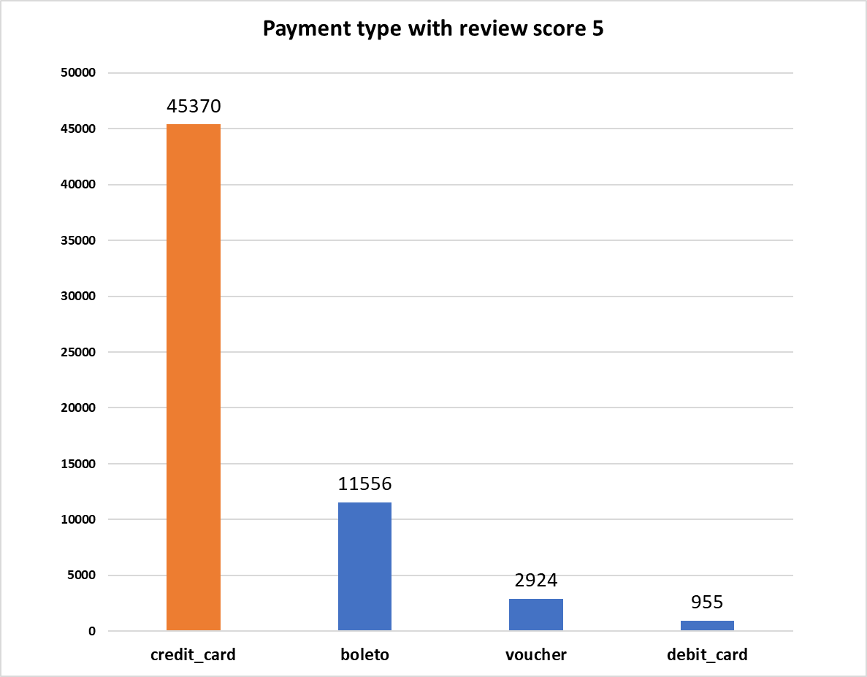
PAYMENT TYPE WITH REVIEW SCORE 5
KPI - 2
NUMBER OF ORDERS WITH REVIEW SCORE AS 5
AND PAYMENT TYPE AS CREDIT CARD
THIS KPI ANALYSES THE NUMBER OF ORDERS WITH A
REVIEW SCORE OF 5 AND PAYMENT TYPE AS CREDIT
CARD. THIS HELPS IN UNDERSTANDING CUSTOMER
SATISFACTION LEVELS AND PAYMENT PREFERENCES.
OLIST CAN USE THIS INFORMATION TO IDENTIFY
SATISFIED CUSTOMERS AND ENCOURAGE THEM TO
MAKE REPEAT PURCHASES.

Slide 7
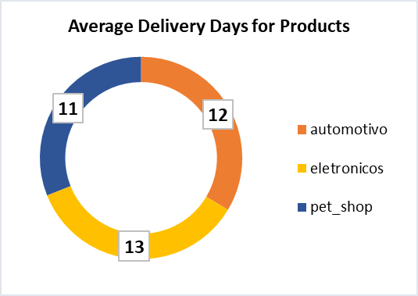
AVERAGE NUMBER OF DELIVERY DAYS TAKEN FOR PET SHOP
KPI - 3
THIS KPI ANALYZES THE AVERAGE NUMBER OF DAYS TAKEN FOR
ORDER_ DELIVERED_CUSTOMER_ DATE FOR PET_SHOP. IT HELPS
OLIST IN IDENTIFYING AREAS WHERE THEY CAN IMPROVE THEIR
DELIVERY TIME AND MAINTAIN CUSTOMER SATISFACTION.

Slide 8
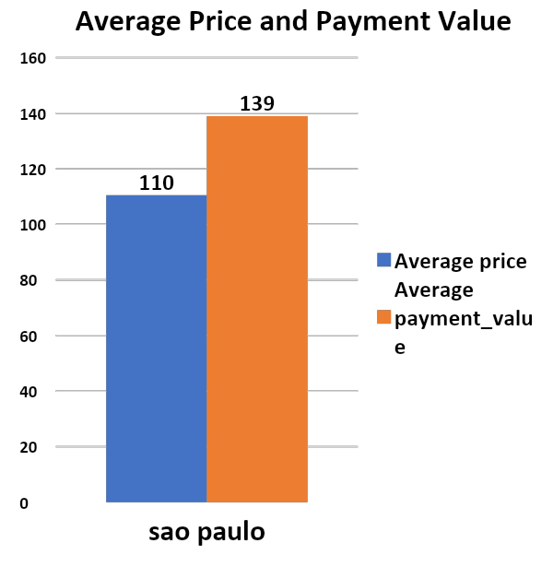
AVG PRICE & PAYMENT FOR SAOPAULO
KPI - 4
THE ANALYSIS OF AVERAGE PRICE AND PAYMENT
VALUES FROM CUSTOMERS OF SAO PAULO CITY HELPS IN
UNDERSTANDING THE SPENDING PATTERNS OF
CUSTOMERS IN THIS REGION. IT ALSO HELPS OLIST IN
IDENTIFYING HIGH-VALUE CUSTOMERS AND CREATING
TARGETED MARKETING CAMPAIGNS.

Slide 9
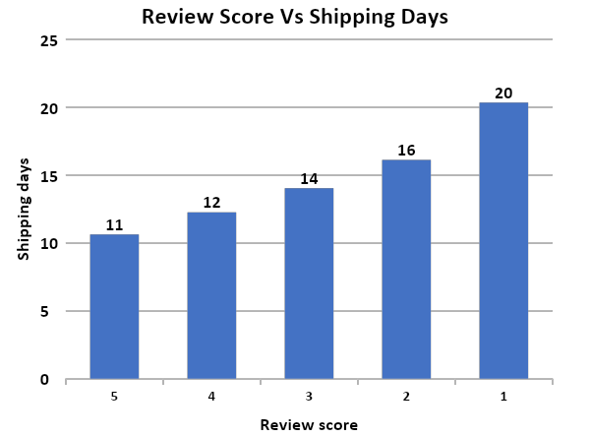
AVERAGE SHIPPING DAYS VS REVIEW SCORES
KPI - 5
THIS KPI ANALYZES THE RELATIONSHIP BETWEEN
SHIPPING DAYS AND REVIEW SCORES. IT HELPS IN
UNDERSTANDING THE IMPACT OF DELIVERY TIME ON
CUSTOMER SATISFACTION LEVELS. OLIST
CAN USE THIS INFORMATION TO OPTIMIZE THEIR
LOGISTICS AND IMPROVE THEIR DELIVERY TIME.

Slide 10

MS EXCEL DASHBOARD

Slide 11
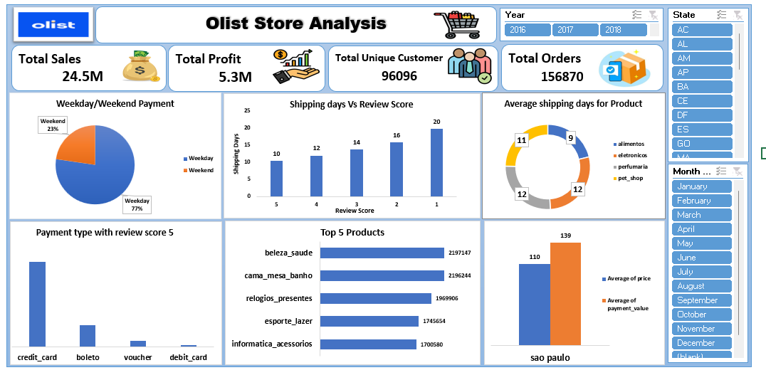

Slide 12

POWER BI DASHBOARD

Slide 13
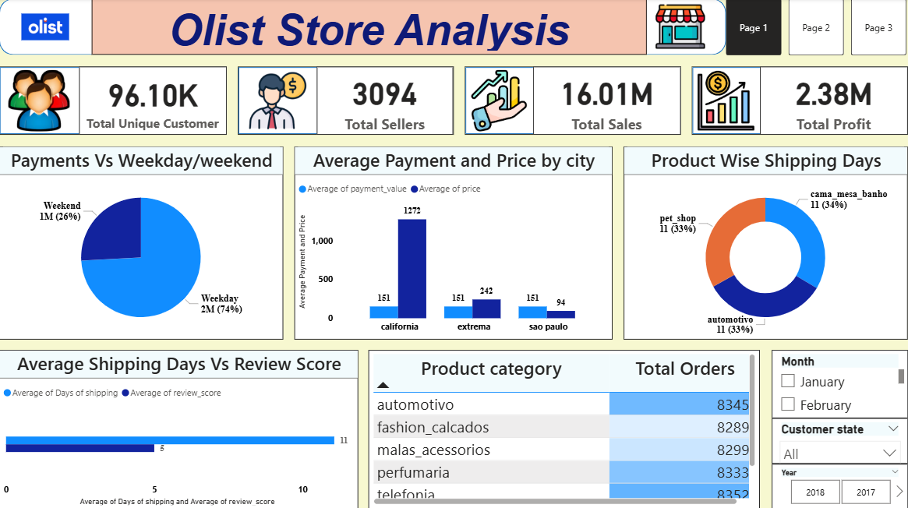
OLIST POWERBI DASHBOARD

Slide 14
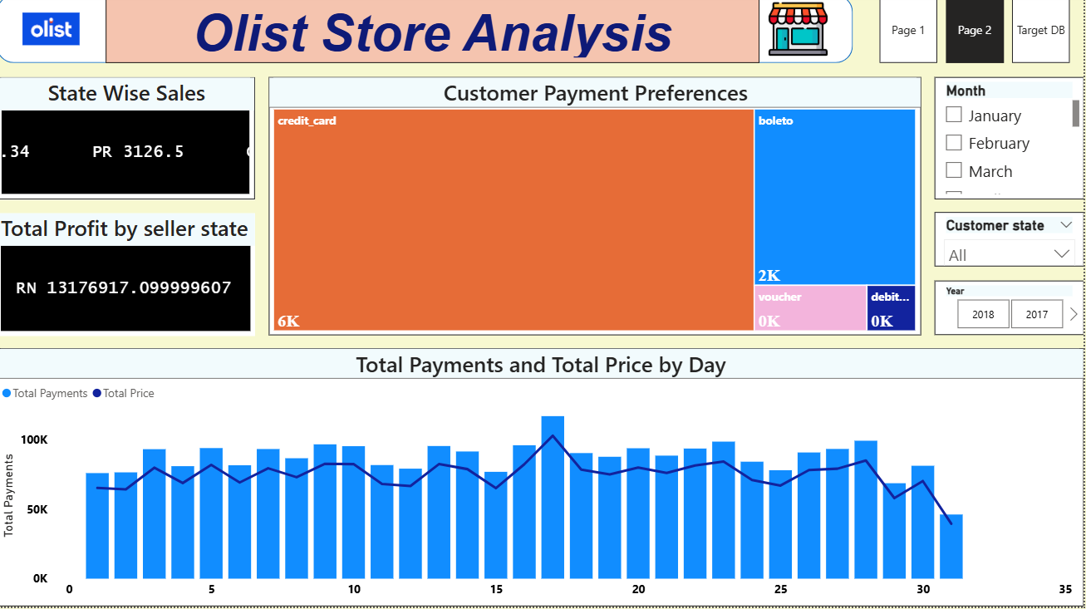

Slide 15

TABLEAU DASHBOARD

Slide 16
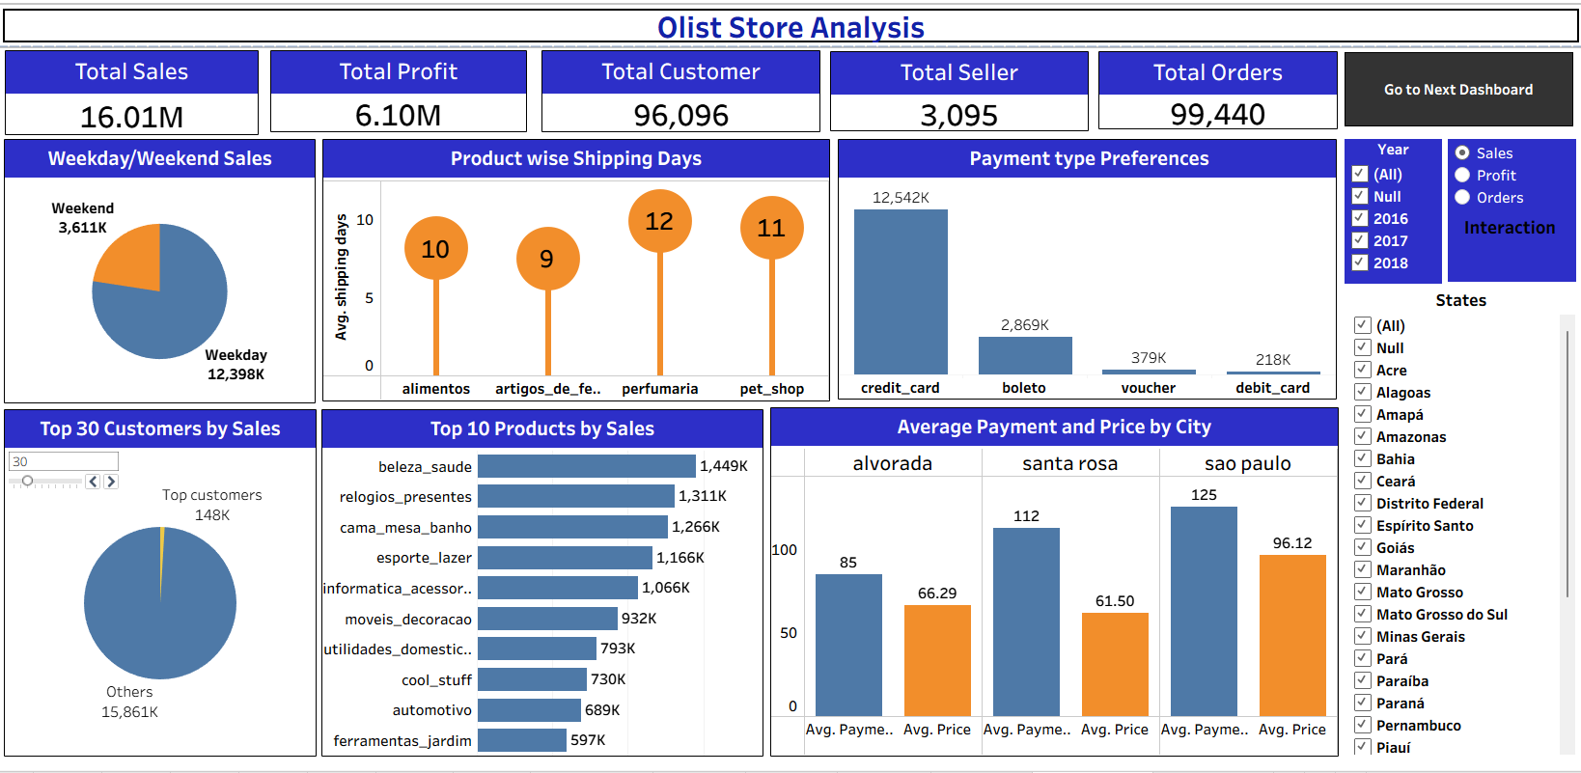

Slide 17
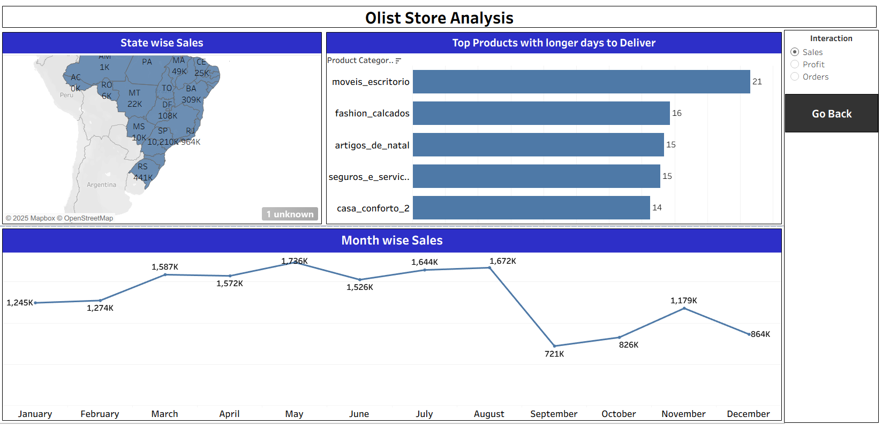

Slide 18

SQL QUERY

Slide 19
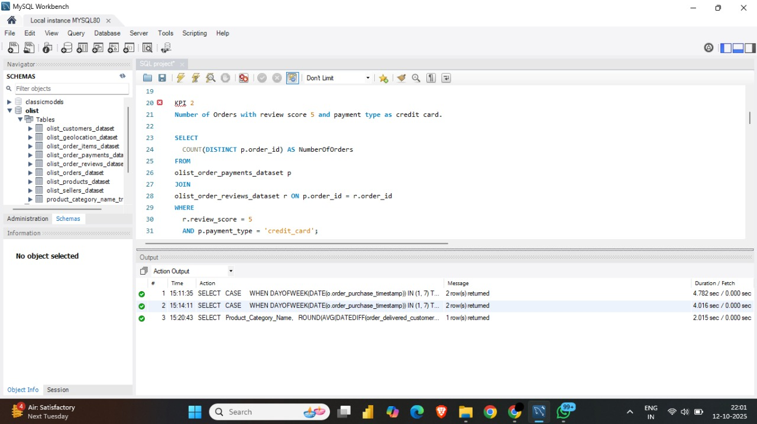
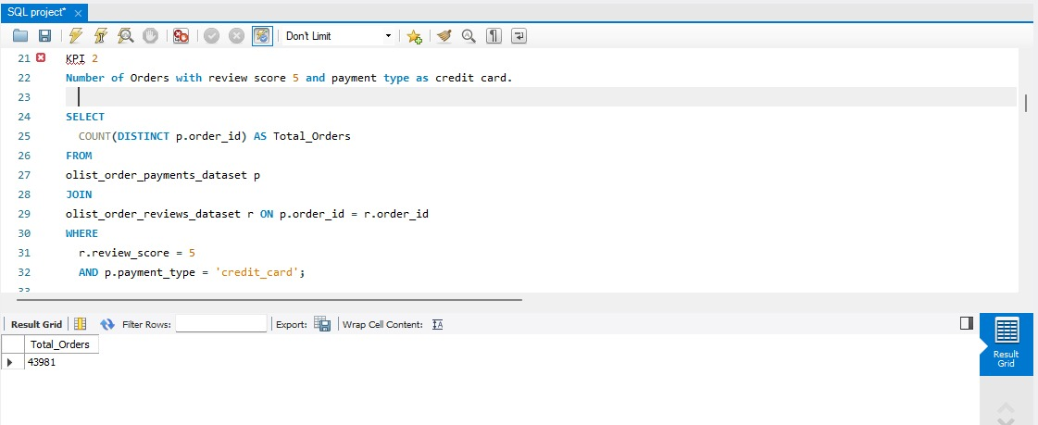
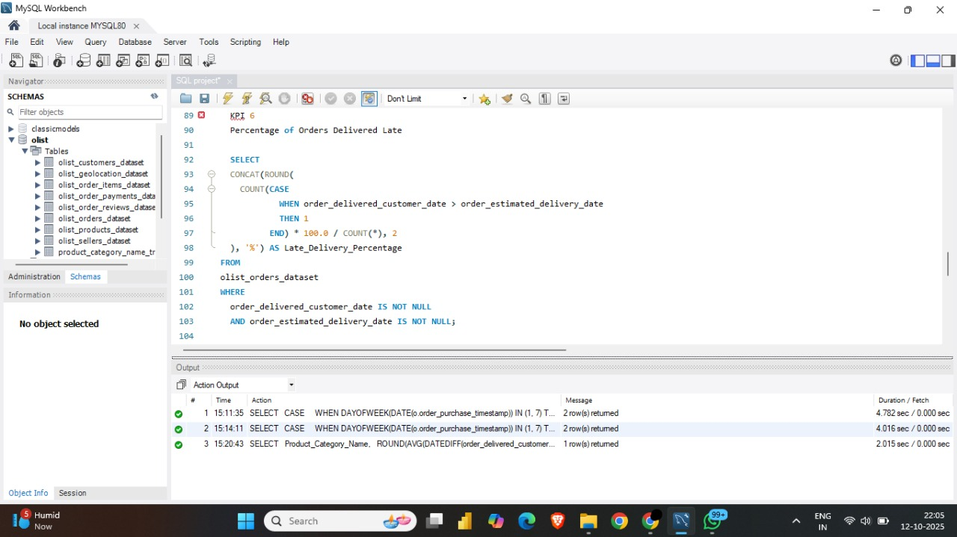
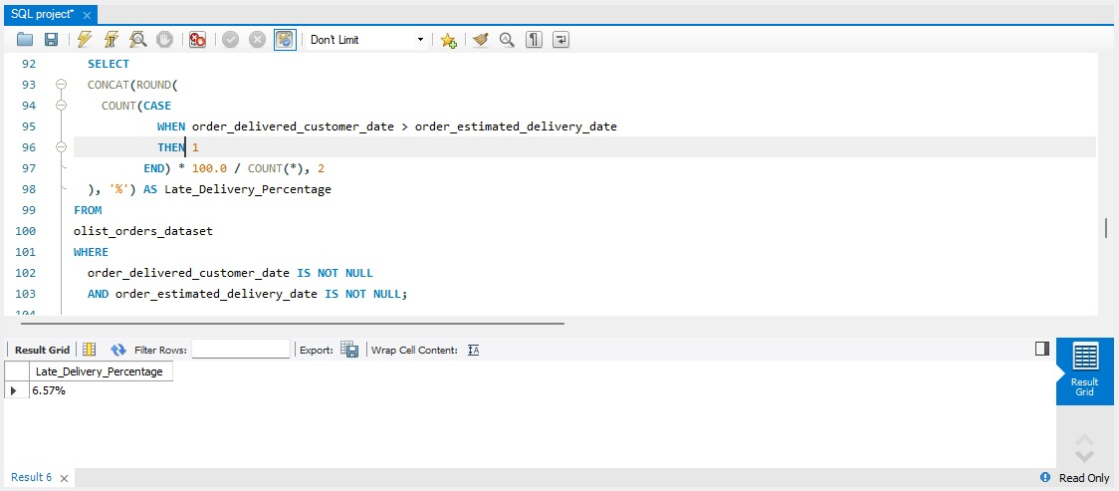
KPI-1 NUMBER OF ORDERS WITH REVIEW SCORE 5 AND PAYMENT TYPE AS CREDIT CARD
KPI-2 PERCENTAGE OF ORDERS DELIVERED LATE
OUTPUT :
OUTPUT :

Slide 20
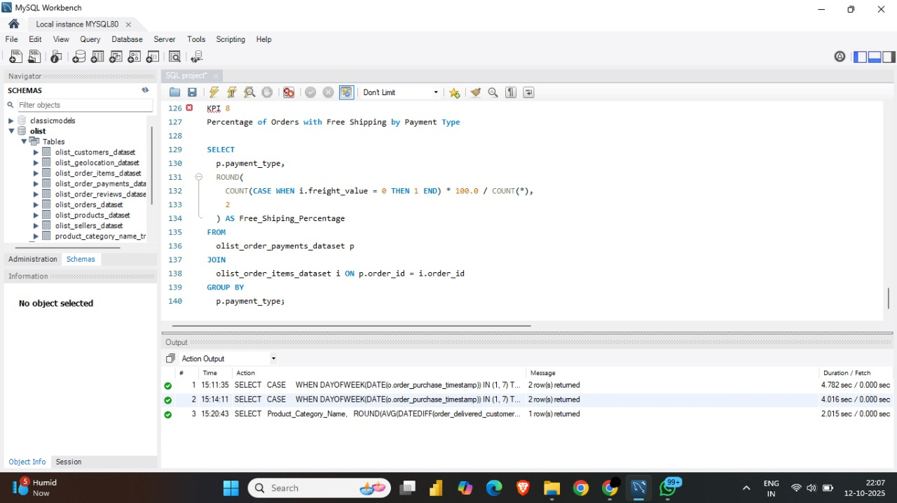
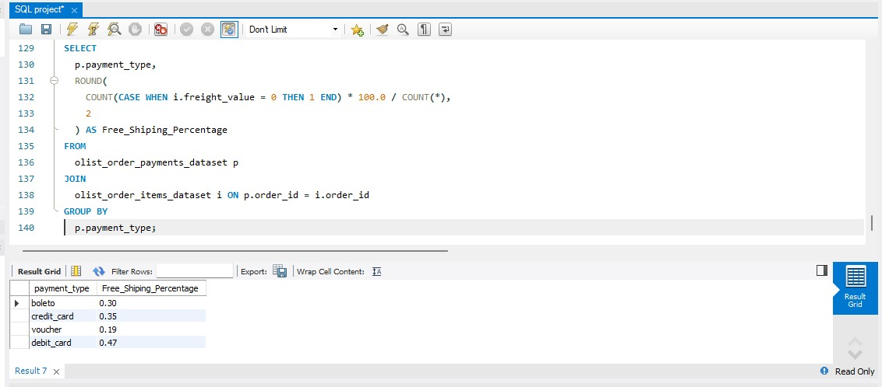
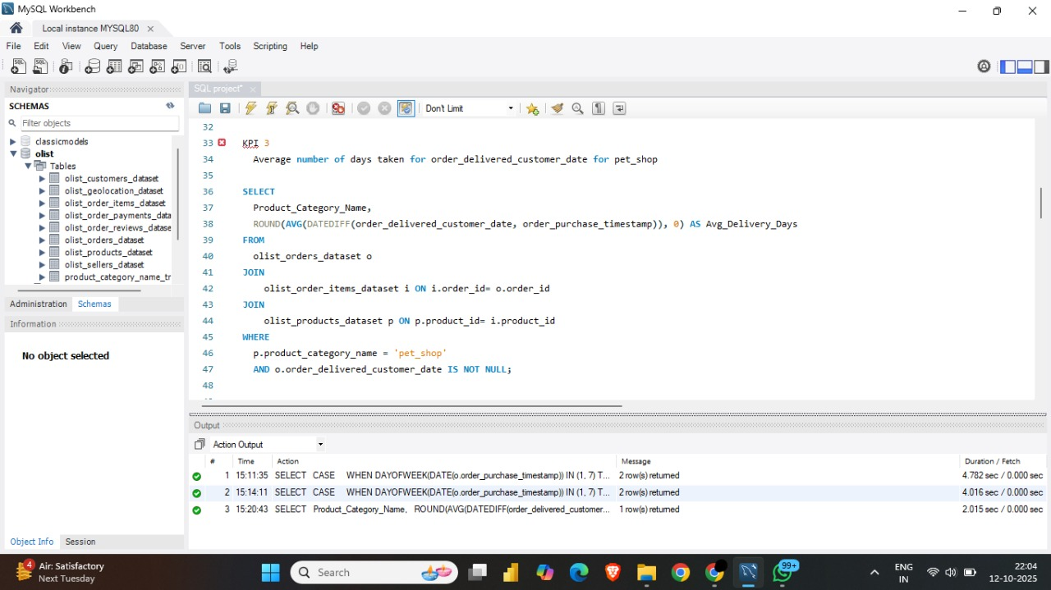
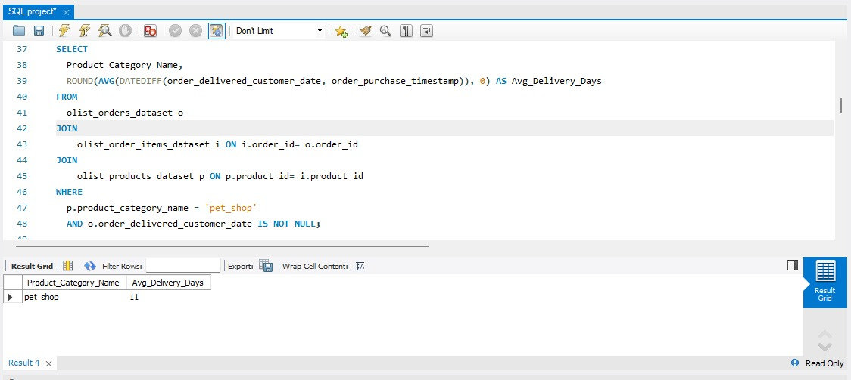
KPI-3 PERCENTAGE OF ORDERS WITH FREE SHIPPING BY PAYMENT TYPE
OUTPUT :
KPI-4 AVERAGE DELIVERY TIME FOR PET SHOP
OUTPUT :

Slide 21
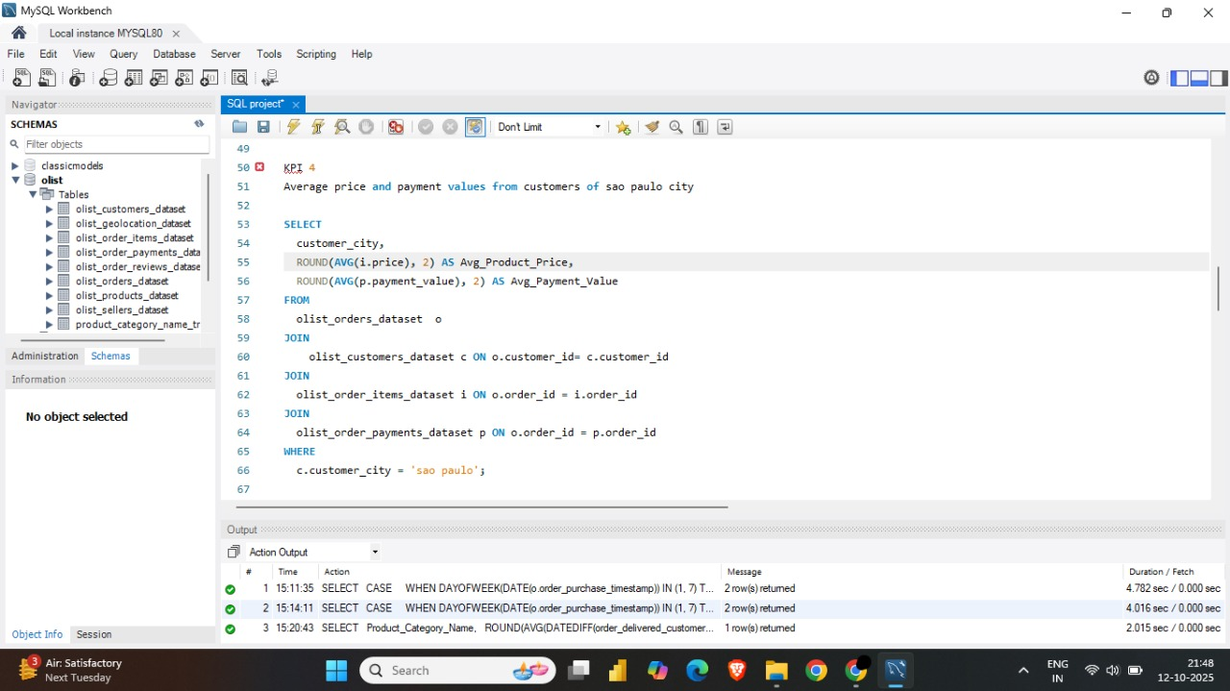
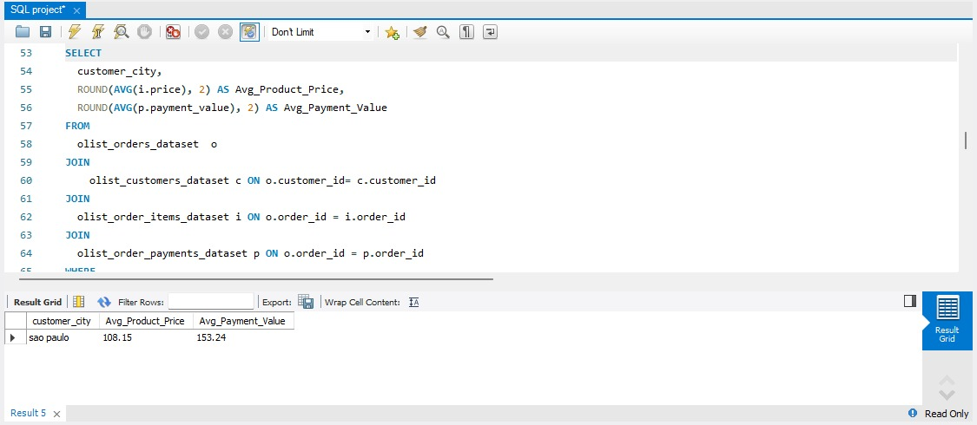
KPI-5 AVERAGE PRICE AND PAYMENT VALUES FROM CUSTOMERS OF SAO PAULO CITY
OUTPUT :

Slide 22
INSIGHTS
TOTAL ORDERS: 99,440
DELIVERED ORDERS: 89,940 → 90% SUCCESS RATE
AVERAGE RATING: 4.09 STARS (RANGE: 2.5 – 4.67 STARS)
1-STAR REVIEWS: 3RD MOST COMMON → POSSIBLE PRODUCT QUALITY ISSUES
DELIVERY PERFORMANCE MAY ALSO AFFECT RATINGS
KEY INSIGHTS:
FOCUS ON HIGH-DEMAND PRODUCT CATEGORIES
IMPROVE PRODUCT AND SERVICE QUALITY
ENHANCE DELIVERY PROCESS TO BOOST SATISFACTION

Slide 23
RECOMMENDATIONS
REGULARLY MONITOR CUSTOMER REVIEWS TO IDENTIFY PRODUCT ISSUES AND IMPROVEMENT AREAS.
USE DASHBOARDS TO SPOT PATTERNS AND GUIDE DATA-DRIVEN DECISIONS.
INVESTIGATE CAUSES OF DELIVERY DELAYS AND UNDELIVERED ORDERS.
ANALYZE GEOGRAPHIC DATA FOR ROUTE OPTIMIZATION AND ACCESSIBILITY ISSUES.
TRACK FLEET PERFORMANCE USING TELEMATICS TO PREVENT PROBLEMS EARLY.
IMPLEMENT A CLEAR SHIPMENT TRACKING SYSTEM FOR BETTER COMMUNICATION.
SEND REGULAR DELIVERY UPDATES TO MANAGE CUSTOMER EXPECTATIONS.
ACCOMMODATE SPECIAL DELIVERY INSTRUCTIONS TO BUILD TRUST AND IMPROVE SERVICE.

Slide 24
SUMMARY
OVERALL, REGULAR MONITORING OF CUSTOMER REVIEWS, REAL-TIME TRACKING OF FLEET PERFORMANCE, TOGETHER WITH PROPER SHIPMENT TRACKING AND A COMMUNICATION SYSTEM CAN IMPROVE OLIST'S DELIVERY AND SUPPLY CHAIN PERFORMANCE AND ENSURE CUSTOMERS ARE HIGHLY SATISFIED WITH THE SERVICE.

Slide 25
CONCLUSION
THE OLIST STORE ANALYSIS PROJECT PROVIDES VALUABLE INSIGHTS INTO CUSTOMER BEHAVIOR AND PAYMENT STATISTICS. THE ANALYSIS OF THESE KPIS HELPS OLIST IN IDENTIFYING AREAS OF IMPROVEMENT AND CREATING TARGETED MARKETING CAMPAIGNS. AS A DATA ANALYST, I HAVE USED EXCEL AND POWER BI TO CLEAN AND MANIPULATE THE DATASET AND CREATE MEANINGFUL VISUALIZATIONS. THIS PROJECT SERVES AS A GREATEXAMPLE OF HOW DATA ANALYSIS CAN HELP BUSINESSES MAKE INFORMED DECISIONS.

Slide 26


